Slide 1
Guidance Utility for Impaired Daily Experiences
Jack Letsinger, Jack Couture, Alyan Tharani, Diana Canchola, Ryan Wu, Noah Kilpatrick

Slide 2
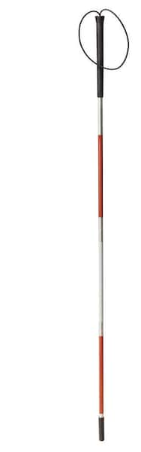
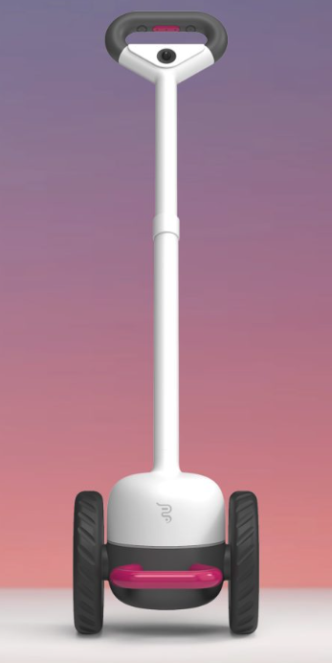
Problem
Development Timeline
1931
White Cane is formally recognized as a tool for the blind
1947
Collapsible cane is developed by Dr.Richard Hoover
Widely used
Little to no
innovation
Compromises:
compatibility
mobility
1921
White cane is invented by James Biggs
1935
The long cane is developed for navigation by Dr.Richard Hoover
21st Century
Adoption of electronic sensors
GPS
Ultrasonic
smart apps
Notes:
Diana

Slide 3
Need
21st century solution to a humanity-long impairment
Incorporate modern sensors and algorithms to provide a better picture of environment for the visually impaired
Full spatial awareness with real-time feedback
Device familiar to the users that will enhance their independence and quality of life
Notes:
Diana

Slide 4



Goals & Objectives
Detect obstacles up to 2m away from the user
Alert the user through the use of handle vibrations
At the 2m, 1m, 0.5m, and 0m distances
Allow the user to adjust the handle vibrations for sensitivity
Full Mobility
Detect Obstacles
Alert Users
Notes:
Ryan Wu
Three main goals for our project
Increase independence for the visually impaired by enabling full mobility in college campuses
Detect Obstacles 2m away from them
Alert users through handle vibrations, explain how the vibrations will change as the obstacle gets closer

Slide 5




Design Constraints
Lightweight design for full mobility.
1.5lb - 2lb in total weight
Durable battery life for day-long use.
3-4 hours of use in one charge
Real-time feedback with little to no delay.
< 0.5 seconds
Size
Weight
Battery Life
Low Latency
Notes:
Ryan Wu
The design constraints are mainly focused around creating the best user experience without compromising functionality
Has to be a small addition to the cane to keep it collapsable and lightweight
Has to last at least 3-4 hours
Has to have near instantaneous feedback to the user about obstacles

Slide 6
Alternate Solutions
Smart Cane with phone app to audibly alert users of obstacles
Audio could impair hearing
SLAM Algorithm to add obstacles into a database
Stretch goal
Infrared Sensor for object detection
Access to other sensors
Belt or bag for users to carry along with the cane
Added baggage for users, eliminates portability
Notes:
Noah
These are ideas we had for the project but we didn’t add in
Discuss the pros and cons of each
1. Phone App
Pro: Have one place where the user could interface with the tool
Con: Audio could impair the hearing of the user and the people around them, the application would have to be accessible to the user
2. SLAM Algorithm
Idea behind this is to track the obstacles the user encounters to build a database and have the cane be smarter by knowing when to anticipate them
Pro: Makes our cane smarter
Con: We set this as a stretch goal if we have time
3. IR Sensor
Pro: Added sensor for increased awareness
Con: We already had access to a depth camera and lidar, pairing the two made most sense to get a picture and distance
4. Bag
Pro: Provide a way to store batteries and wires in a wearable way
Con: Added component for users that may be cumbersome

Slide 7
OUR SOLUTION

Slide 8
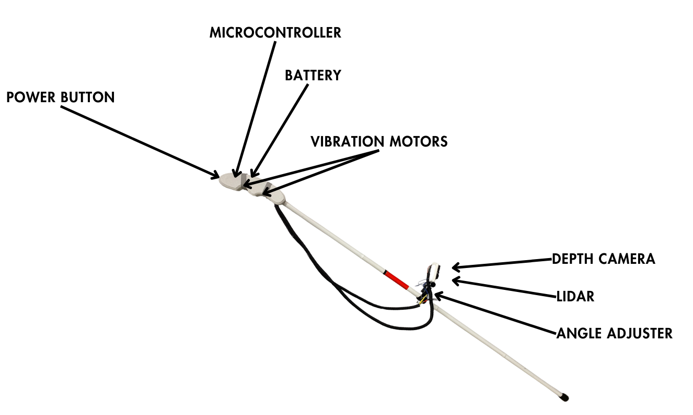
Final Design
Internal/External Design
Externally
Completed handle
Completed sensor mount
Internally
Single rechargeable 9V
Choice of Python > C++
Electronic components
Notes:
Noah

Slide 9
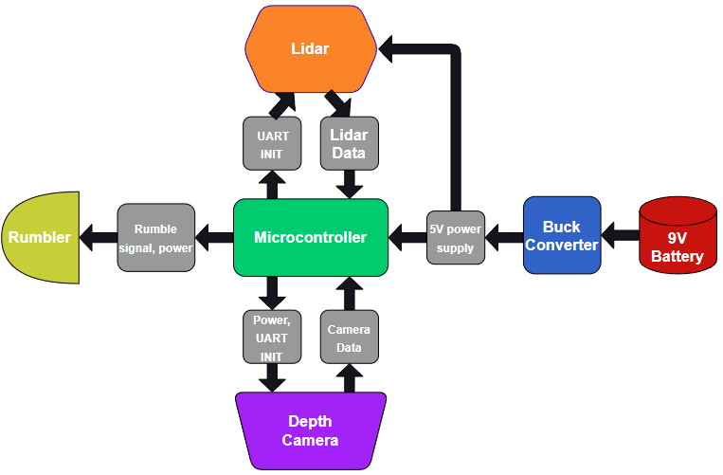
System Description
Overall System Design
Initial Proposal
All sensors, microcontrollers, and feedback working the same as initially drafted
Changes
Buck converter will step down the 5V input for all devices
Due to the # of terminals on the Converter, the depth camera will be powered through the Pi.
Notes:
Ryan
Buck converter due to 9V battery
Using 9V battery due to size
Most of our components use 5V
Bc not enough terminals on the converter, use raspi pico to power the depth camera
We connect the LiDAR and the Depth camera to the raspi pico through the UART so that we can receive data in readable form.
Connect vibration motors to the GPIO pins on the raspi pico

Slide 10
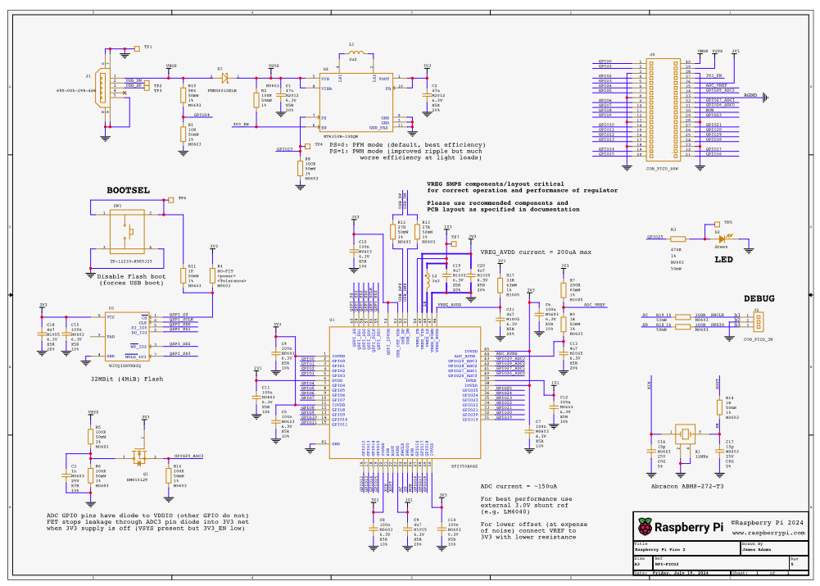
System Description (Cont.)
Component Specific Details
Raspberry Pi Pico
Handles all communication between each system part
Dual-core ARM Cortex-M33 processor provides a sufficient clock speed (150 MHz) to handle computation
21 mm x 51 mm size, 1.8-5.5V input power
9V Battery
48.8 mm x 26.0 mm, 0.265 lbs
Stronger, rechargeable battery reduces overall size
Buck Converter
22 mm x 17 mm, 0.106 oz
Converts 9V battery input to 5V input for components
Notes:
Ryan
Buck converter due to 9V battery
Using 9V battery due to size
Most of our components use 5V
Bc not enough terminals on the converter, use raspi pico to power the depth camera
We connect the LiDAR and the Depth camera to the raspi pico through the UART so that we can receive data in readable form.
Connect vibration motors to the GPIO pins on the raspi pico

Slide 11
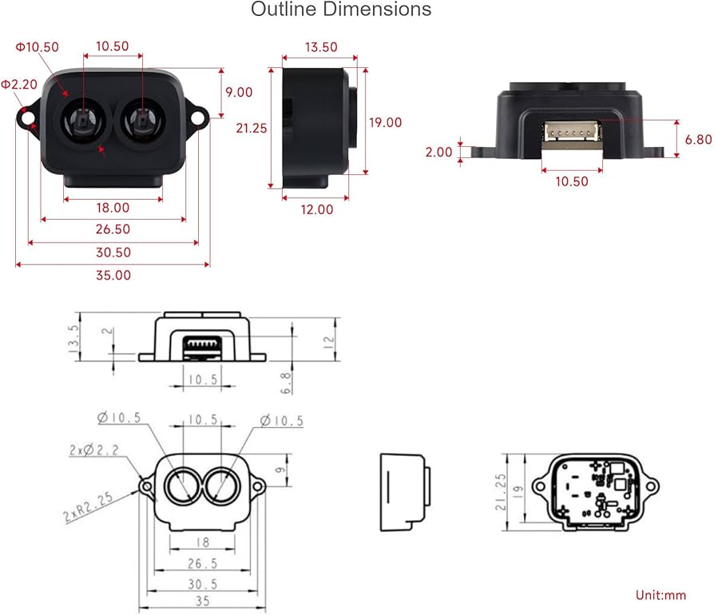
System Description (Cont.)
Component Specific Details
Depth Camera
10mm x 2.7 mm
Powered through Pico
19 ms - 25 ms response time
LiDAR
10mm x 2.7 mm
8 ms - 11 ms response time
Notes:
Ryan
Buck converter due to 9V battery
Using 9V battery due to size
Most of our components use 5V
Bc not enough terminals on the converter, use raspi pico to power the depth camera
We connect the LiDAR and the Depth camera to the raspi pico through the UART so that we can receive data in readable form.
Connect vibration motors to the GPIO pins on the raspi pico

Slide 12
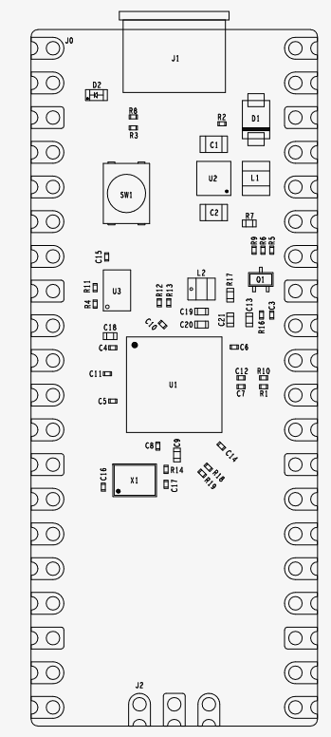
Hardware
The Use Case:
Sensors, brought together by a microcontroller, must:
Accurately paint a picture for the user
Be lightweight and easily transportable
Be energy efficient for a suitable battery life
While each piece of hardware and their codebase already exist, the effectiveness of the design will come from the integration of all components to a final product.
Notes:
Jack L

Slide 13
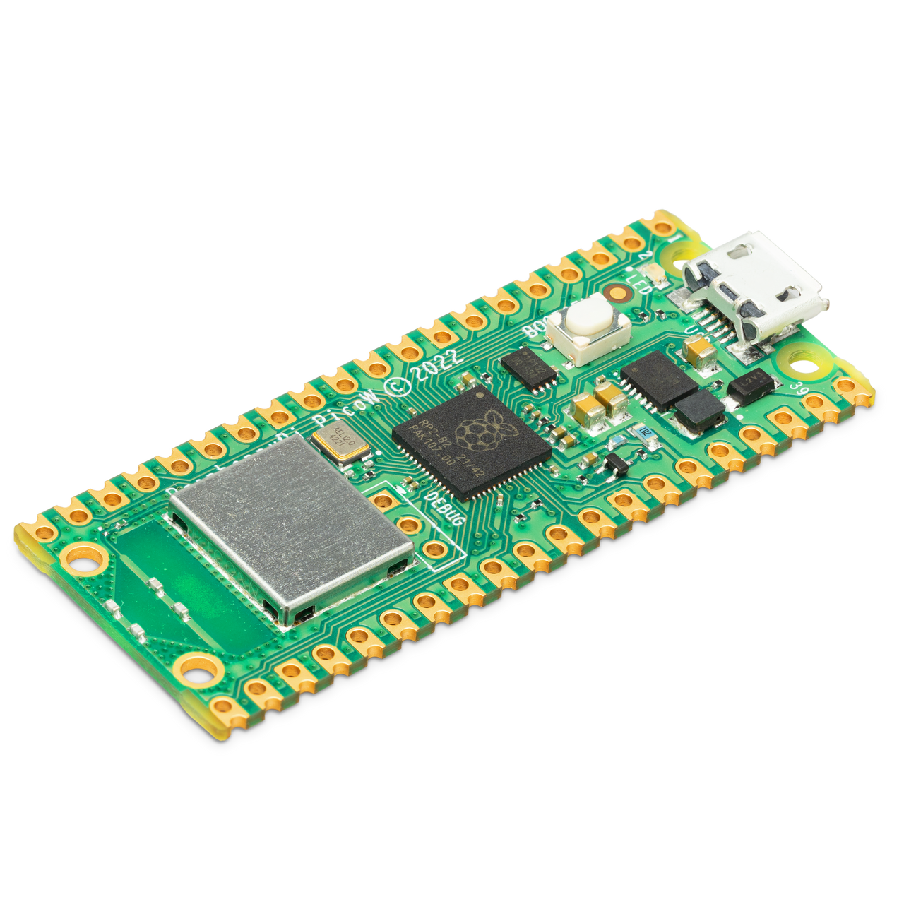
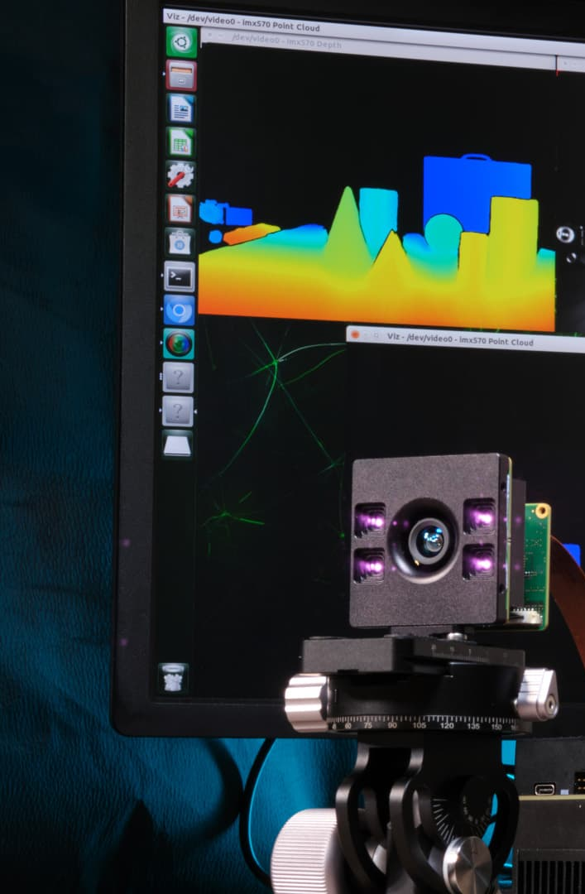
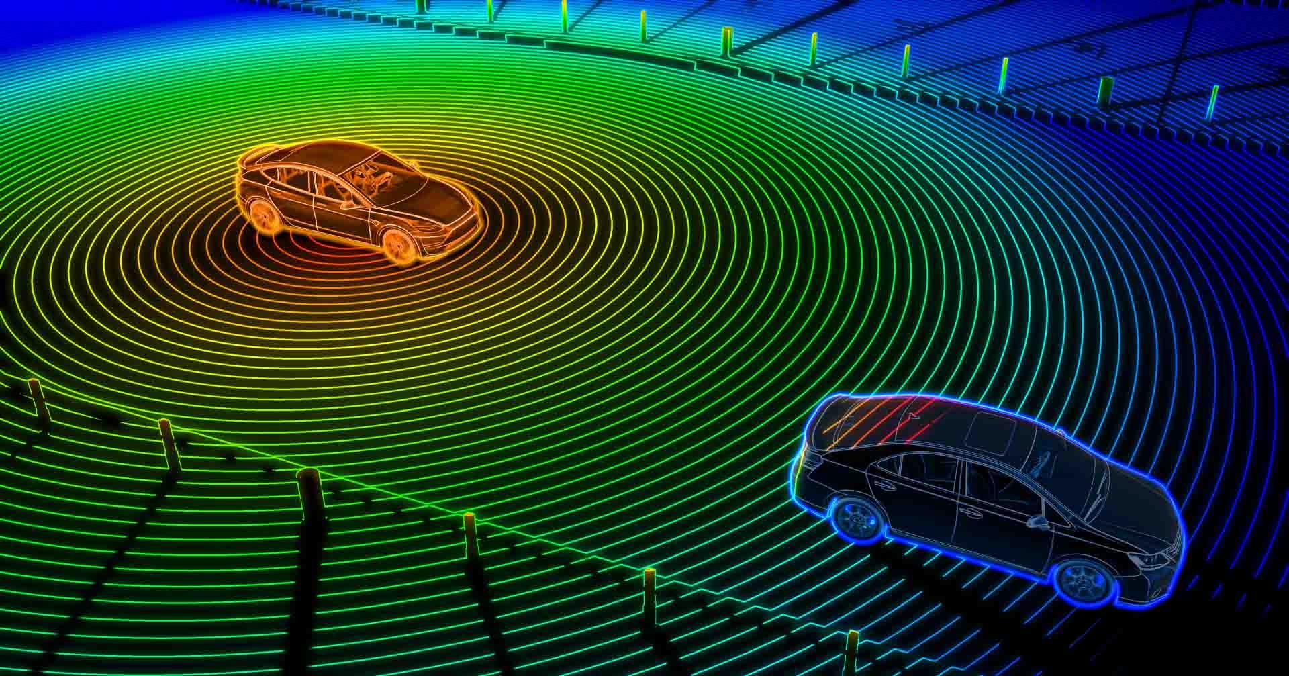
Hardware (Cont.)
Microcontroller: Raspberry Pi Pico 2
Extremely power efficient
UART/Serial port capabilities (as opposed to I2C or SPI)
Python/C/C++ capabilities, access to the Raspberry PI SDK.
Lidar vs. Depth Cameras
Both provide “vision”
Lidar scans provide a rapidly updating distance of objects in front of it (single value)
Depth camera measures objects in a frontal cone pattern (image)
Rumbler
Haptic feedback will alert the user of nearby objects in the probed direction
Our project plans to utilize multiple types of sensors
Notes:
Jack L

Slide 14

Software
System Overview:
Microcontroller (e.g., Raspberry Pi Pico)
LiDAR Sensor
UART-based for distance measurement
Depth Camera
UART-configurable for depth sensing
Outputs:
LED indicator
Buzzers for alert levels
Notes:
Jack C

Slide 15
Software (Cont.)
Initialization:
Configure UART communication with sensors
Initialize depth camera with AT commands
Data Reading:
LiDAR
Reads distance packets starting with ‘YY’
Depth Camera
Non-blocking reads to prevent main loop from stalling
Processes data packets for average distance over the pixels
Notes:
Jack C

Slide 16
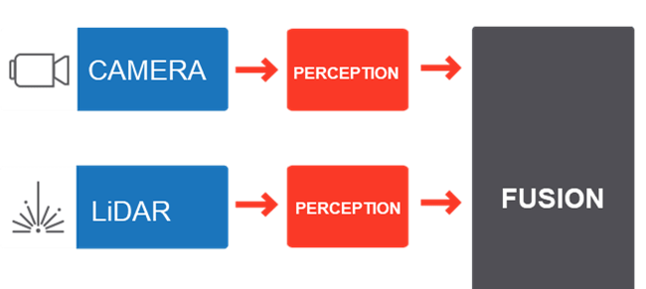
Software (Cont.)
Main Loop:
Collect LiDAR readings continuously
Initiate depth camera reading every 100 LiDAR scans or every 10 seconds
Combine readings for average distance and correct output
Output:
Distance thresholds
Moderate distance (1m-2m)
Closer distance (0.5m-1m)
Closest Distance (< 0.5m)
Notes:
Jack C

Slide 17
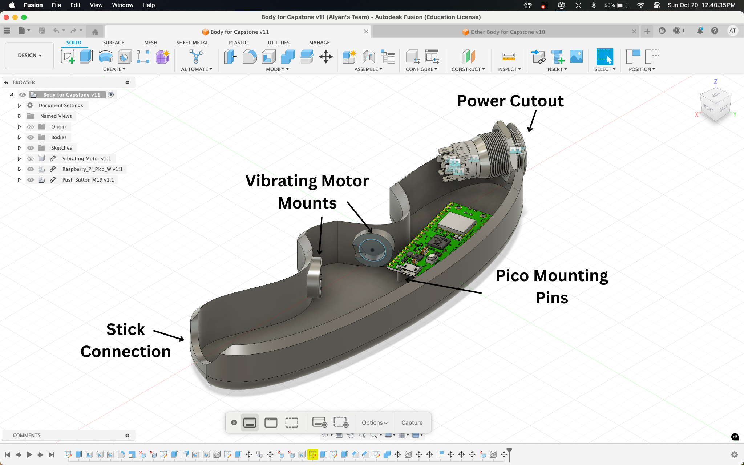
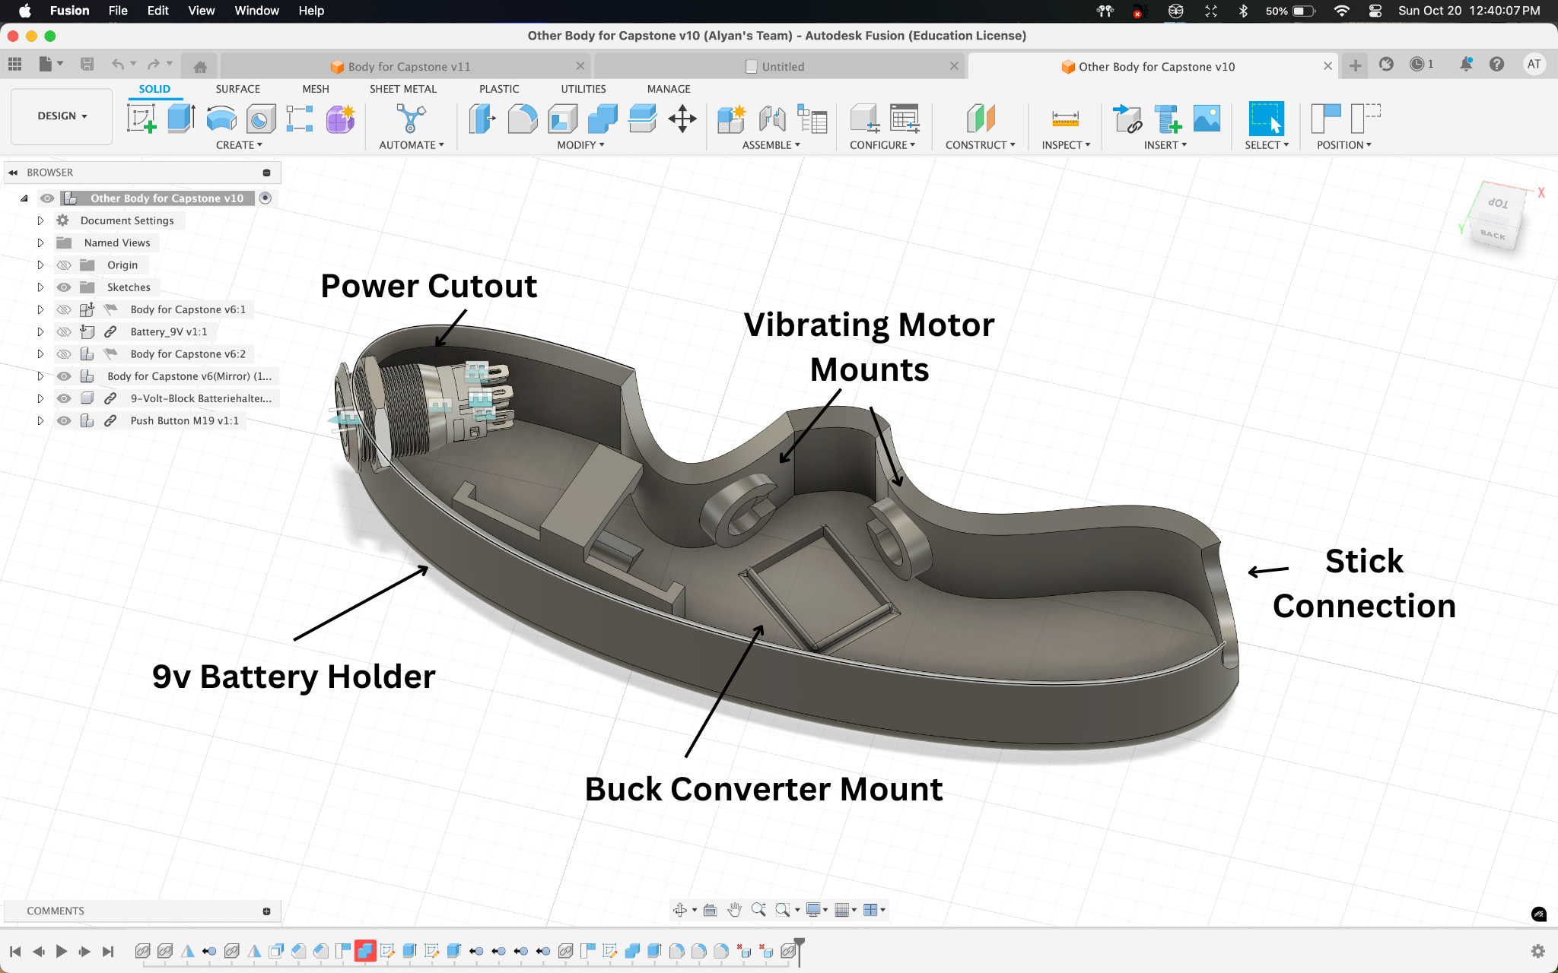
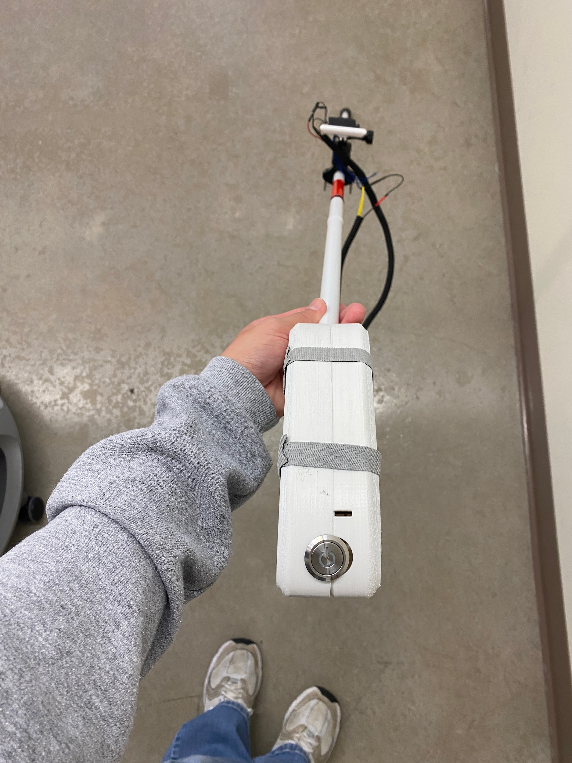
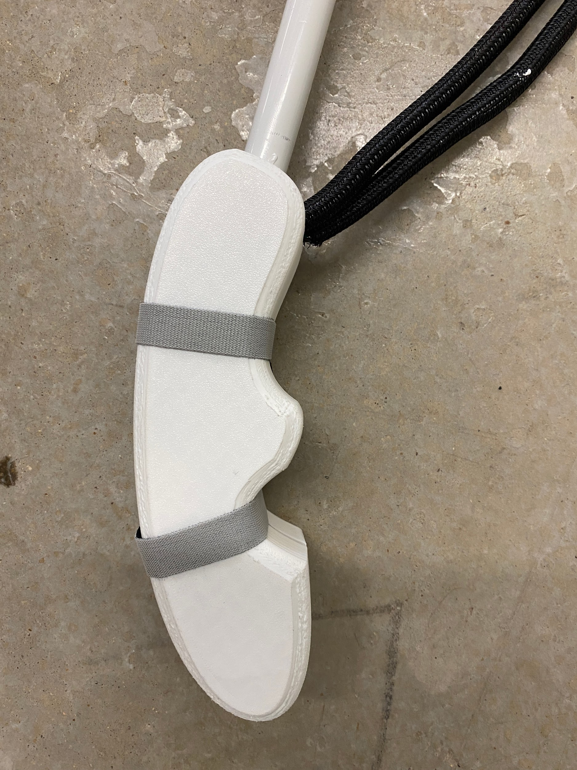
3D Modeling
Final 3D Design of Handle
Final Implementation of Handle
Design Considerations
Comfortably fit all hardware except for sensors
Allow for vibrations to alert the user
Lightweight
Tightly fit onto the walking stick
Notes:
Alyan

Slide 18
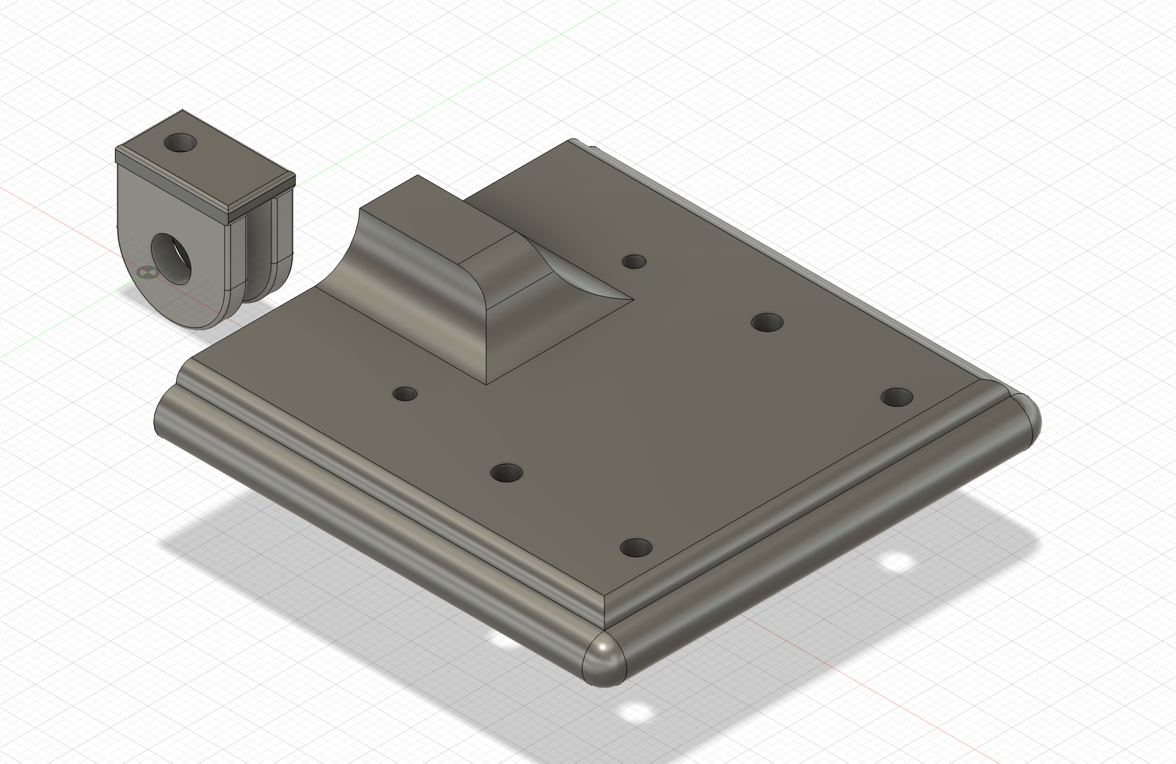
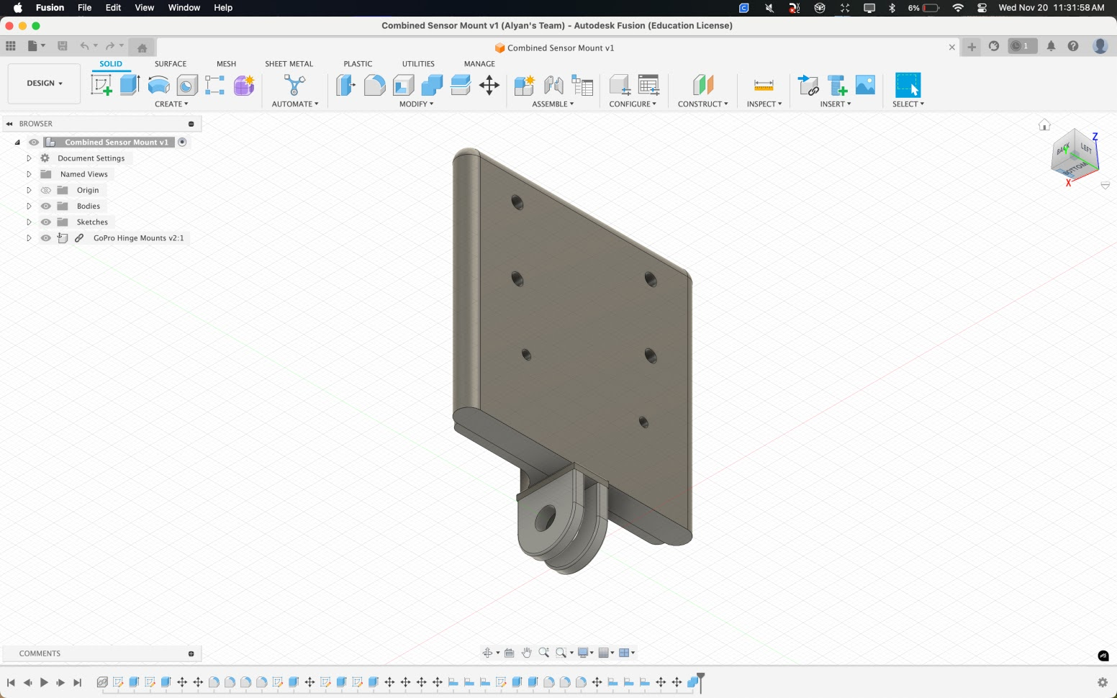
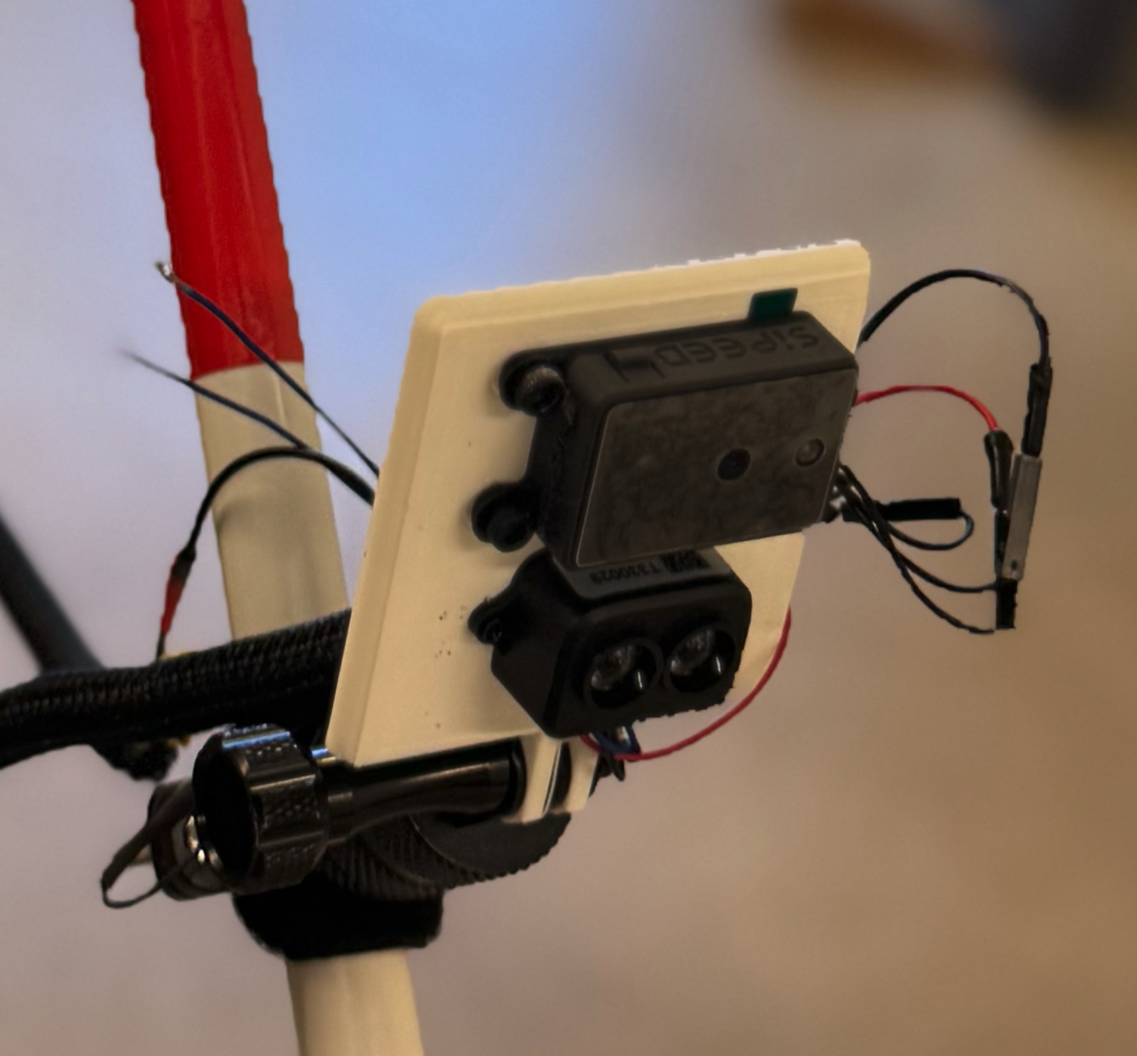
3D Modeling
Final 3D Design of Sensor Mount
Final Implementation of Sensor Mount
V1
V2
Design Considerations
Allow for angle adjustment user to user
Height
Holding angle
LiDAR provides pin point accuracy (bottom)
Notes:
Alyan

Slide 19
Design Validation
Mobility
Weight of entire cane must be less than 2 lb
The cane must be collapsable as per the original design
The cane must easily be moved back and forth.
Full functionality should be available for 3-4 hours
Obstacle Detection
GUIDE will detect obstacles at least 2m away
Detection should be tested in sunny/cloudy/rainy conditions
GUIDE will be functional in grass, pavement, mulch, and dirt.
Detection should be tested on curbs, pedestrians, bikers, scooters, medians
User Alert
User will be alerted within 0.5 seconds of GUIDE algorithm determining obstacle.
Intensity of the vibrations will increase from 2m, 1m, 0.5m and 0m
Notes:
Noah

Slide 20
Environmental Health/Safety
Energy Efficiency
Utilized commercially available batteries.
Rechargeable battery to decrease waste.
User Safety
Haptic feedback was used to not overwhelm users and increase the risk of an accident.
Design
Lightweight to decrease strain
Compactability to allow for portable access
Considerations: Insulate materials to make it waterproof
Notes:
Noah

Slide 21
Social, Political, and Ethics
Enhanced Independence
Enhances awareness of their environment to provide increased independence
User Privacy
No external connection collecting data of their location
No database storing location information or obstacles encountered
Advocacy and Awareness
Lead to a conversation on how to better support the population with visual impairment
Provides a better path towards equity in our society for those with visual impairments
Notes:
Alyan

Slide 22
Manufacturability, Sustainability, Economics
Adaptation
Utilized the commonly used white walking stick to innovate increasing manufacturability
Scalability
Modular approach to sensor selection
Any sensor can be attached to GUIDE if requirements change
Design
Lightweight to decrease strain
Compactability to allow for portable access
Notes:
Alyan

Slide 23
TEAM MANAGEMENT

Slide 24
Budget
 | Amount | Amount per Unit | Cost per Unit | Dimensions | Weight | Total Amount ($)
Walking Stick | 1 | 1 | $17.99 | 53in x 0.5in - Rod 7in x 1in - Handle | 0.55lb | $17.99
Power Button | 1 | 1 | $9.99 | 16mm | 0.35 ounces | $9.99
Vibrating Motor | 2 | 8 | $7.59 | 10mm x 2.7mm | 0.63 ounces | $7.59
LiDAR | 1 | 1 | $23.99 | 10mm x 2.7mm | 0.176 ounces | $23.99
Depth Camera | 1 | 1 | $43.00 | 10mm x 2.7mm | 10.6 ounces | $43.00
Buck Converter | 1 | 6 | $1.67 | 22mm x 17 mm | 3g | $10
Raspberry Pi Pico 2 | 2 | 2 | $6.25 | 21mm x 51mm | 4g | $12.50
9V Battery Holder | 1 | 10 | $0.50 | 0.94"L x 0.47"W x 0.28"H | <1g | $4.99
9V Battery (Rechargeable) | 1 | 4 | $5.25 | 48.8mm x 26.0mm | 0.12kg | $20.99
PLA Printer Filament | 1 | 1 | $0.055 (per g) | N/A | 63g | $3.50
Angle Adjuster | 1 | 1 | $13.99 | 2.95” x 2.56” x 0.98” | 0.09kg | $13.99
Total (s) | N/A | N/A | N/A | N/A | 44.72 oz or 2.795 pounds | $168.53
Notes:
Diana

Slide 25
Project Management
Team | Leader | Members
Hardware | Jack Letsinger Finalize and order parts Oversee breadboard prototype Test sensor capabilities | Ryan Wu Soldering and component integration Breadboard prototype
 |  | Alyan Tharani GUIDE handle 3D modeling GUIDE electronic housing 3D modeling
Software | Jack Couture Oversee software prototype Depth Camera decoding script Depth Camera image generation | Noah Kilpatrick Sensor data packets decoding Depth Camera decoding script
 |  | Diana Canchola LiDAR data packet decoding LiDAR python script to output distances
Overall Lead: Diana Canchola
Notes:
Diana

Slide 26
Testing Results

Slide 27
Final Demonstration Plan
Scenario 1
Location: EABA
Classroom objects scattered throughout the hallway
User will walk down the hallway and office area
Goals
Detect all obstacles in the hallway, show vibrations
Display chart with distances vs vibration frequency (2m, 1m, 0.5m)
Scenario 2
Location: EABA
Several people walking across the hallway
User will walk through the hallway and office area
Goals
Detect all of the people moving
Display chart with distances vs vibration frequency (2m, 1m, 0.5m)
Scenario 3
Location: Outside of EABA
Several people walking outside
Navigating a curb, medians, and sidewalks
Goals
Show GUIDE can navigate outdoor environments
Detect all outdoor obstacles
Display chart with distances vs vibration frequency (2m, 1m, 0.5m)
Notes:
Jack L

Slide 28
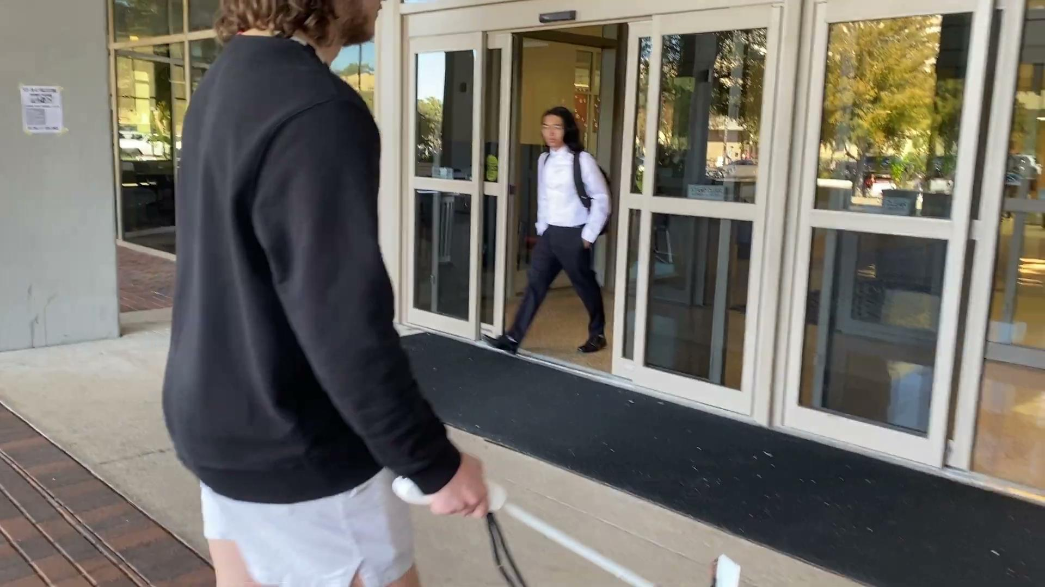
Demo Video
Notes:
Jack C

Slide 29
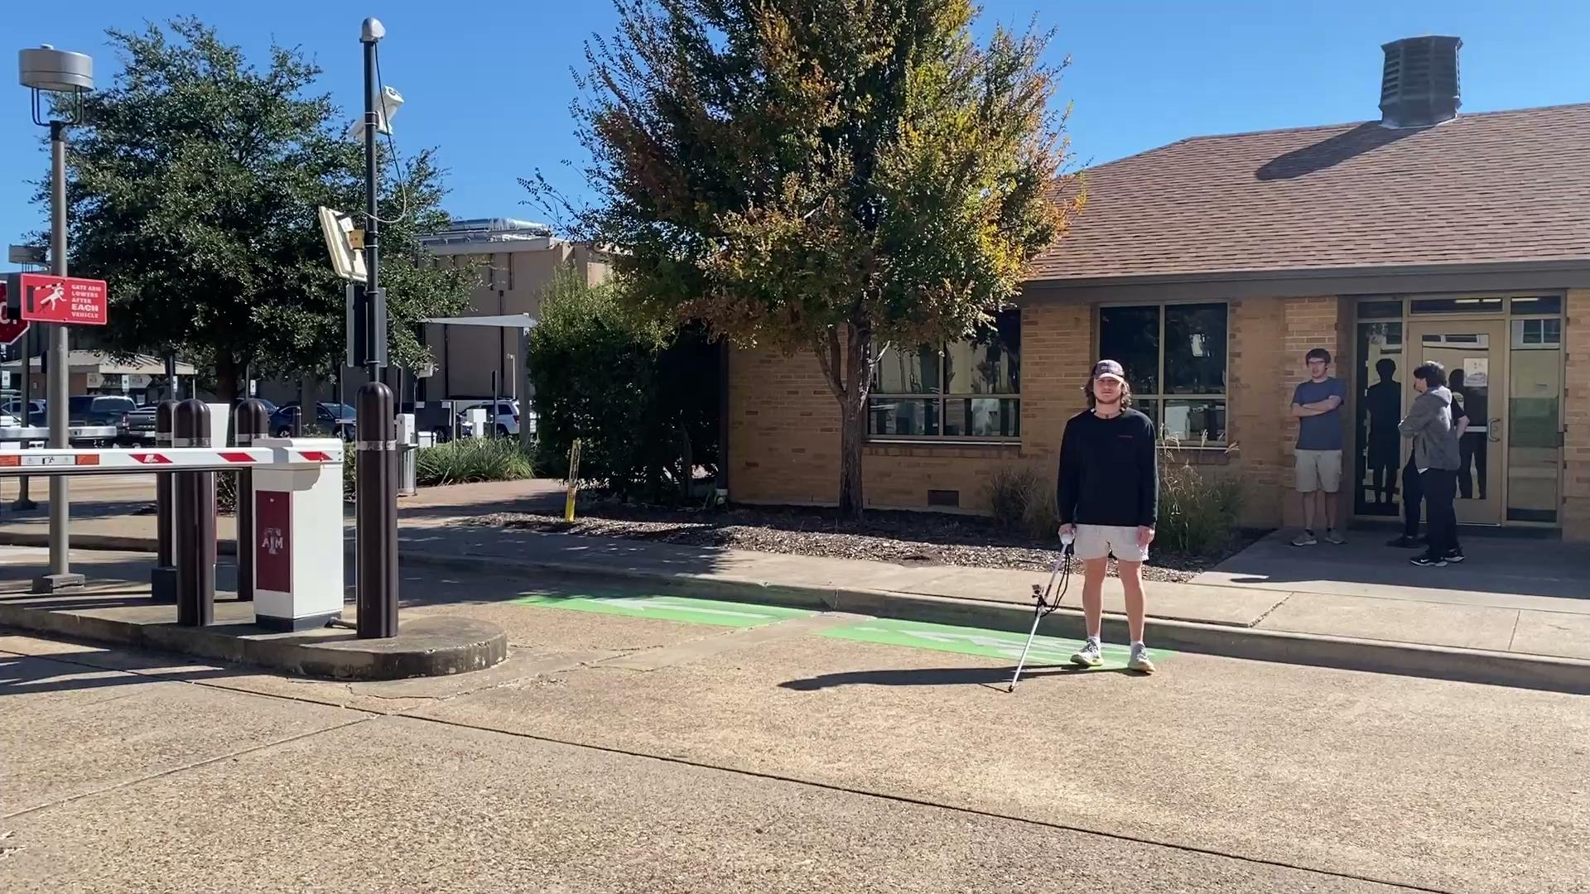
Demo Video
Notes:
Jack C

Slide 30

Evaluation of Results
Using a tape measure we stood 2m away from the user holding GUIDE
When weighed GUIDE was 1.8lbs
Haptic feedback was recorded to be ~44ms
GUIDE provided haptic feedback at 2m, 1m, and 0.5m distances
Battery life is within 2 hours with a 1 hour recharge
GUIDE was able to detect all obstacles in every tested environment as shown previously
 | No Lidar | Lidar
No Depth Camera | N/A | 9.97 ms
Depth Camera | 21.98 ms | 44.14 ms
Notes:
Jack L

